Slide 1
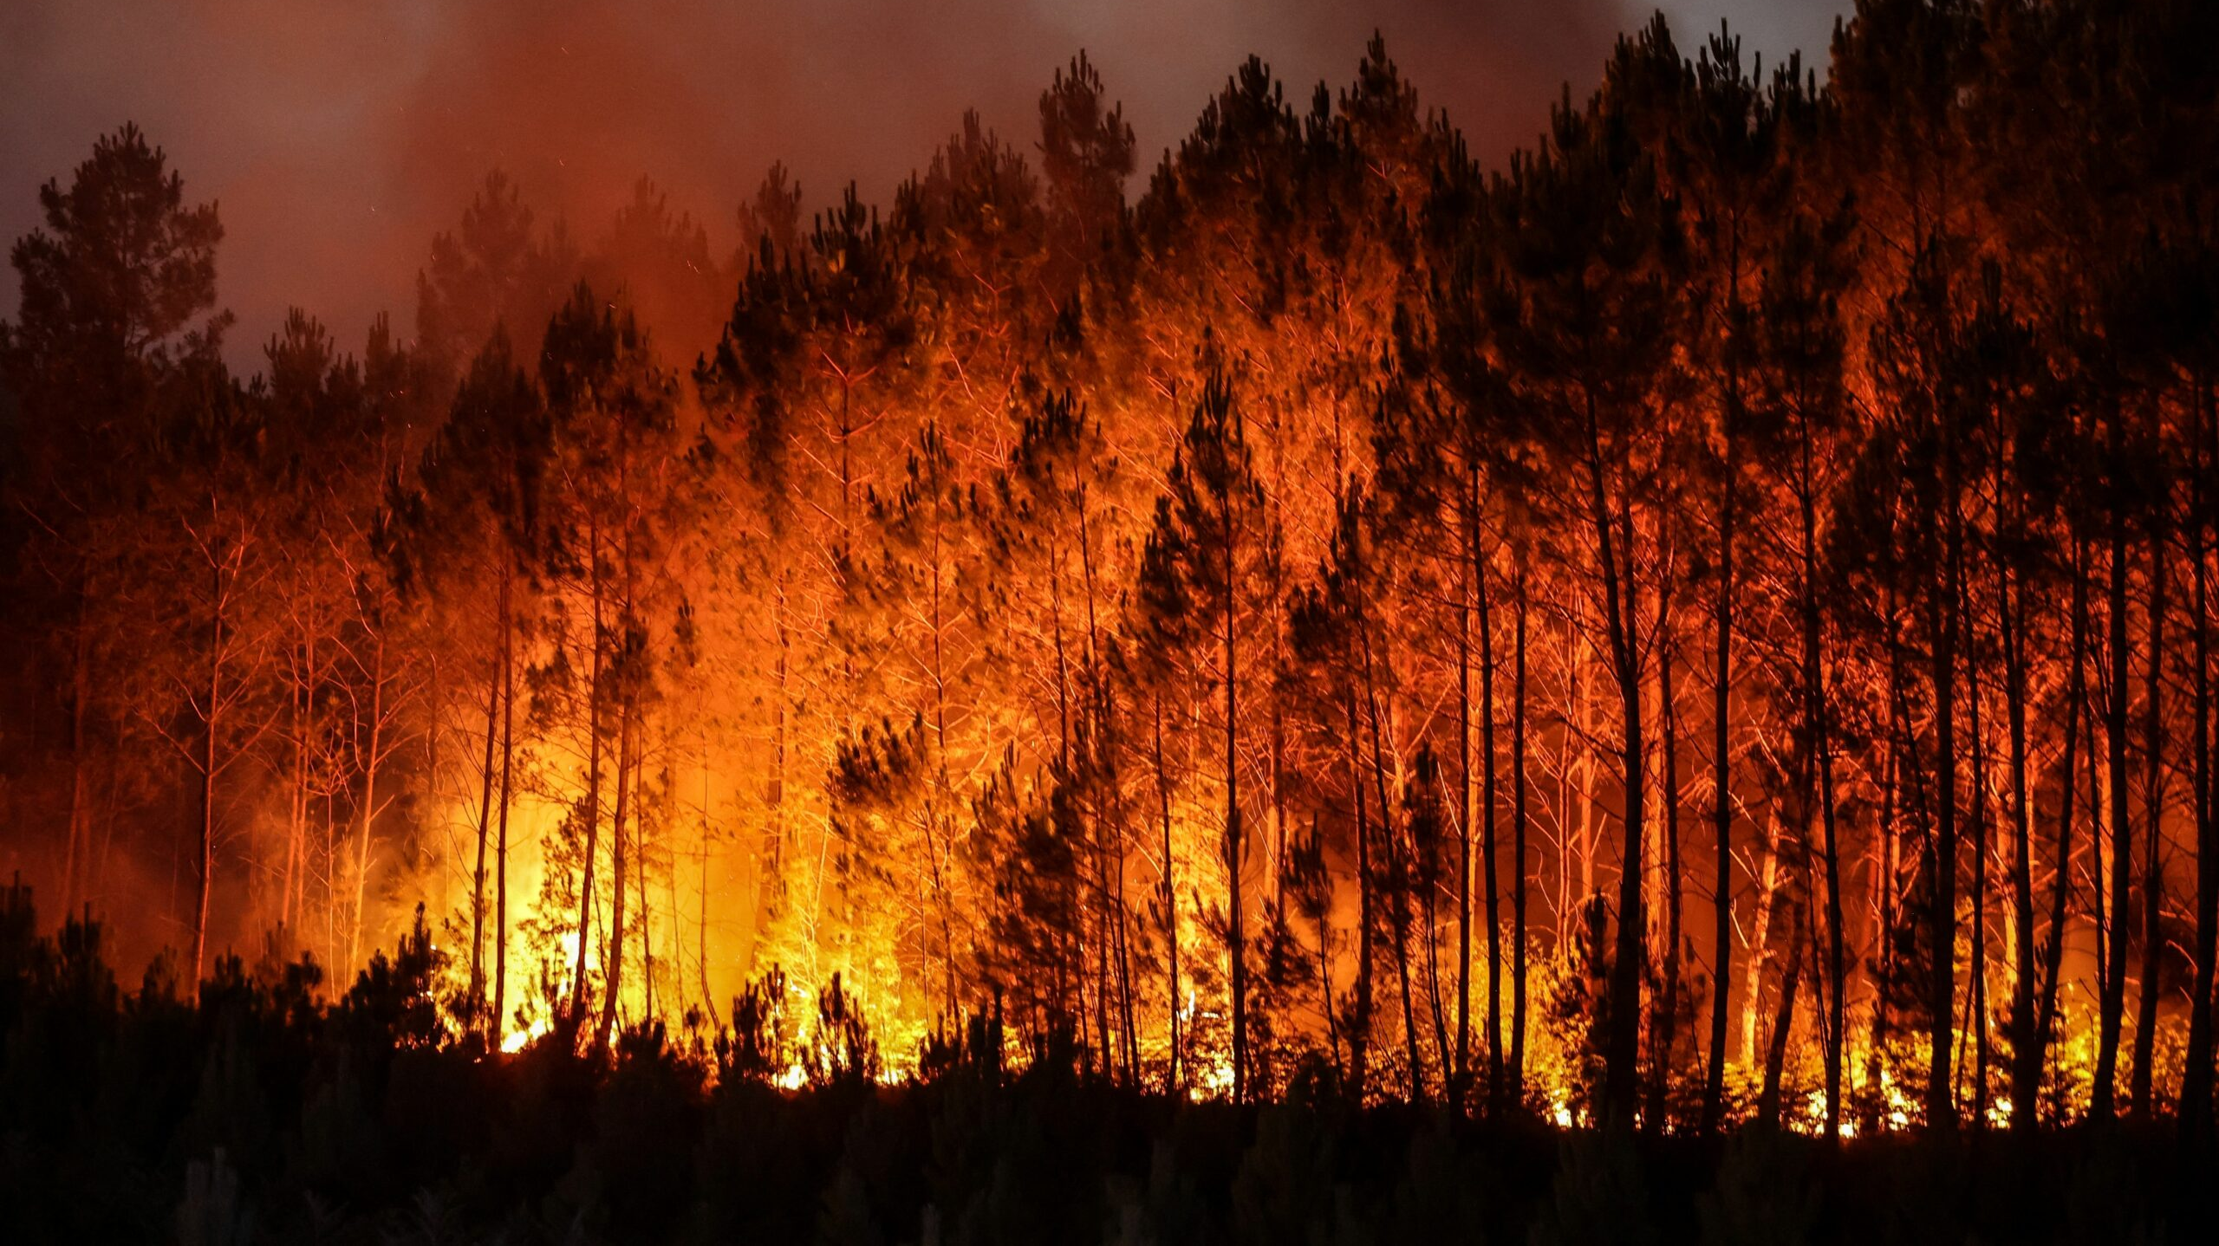
YQuantum 2025 Team NAP
Tahoe Quantum Wildfire Response

Slide 2

The Solution
Resource allocation problem statement: A fire is rapidly spreading within an area and firemen, along with their resources, must be allocated to the fires while ensuring that adequate manpower is at each fire at a reasonable time.
Allocating teams to wildfire outbreaks based on numerous parameters.
Expandable system that can integrate more factors, based on more available data.

Slide 3
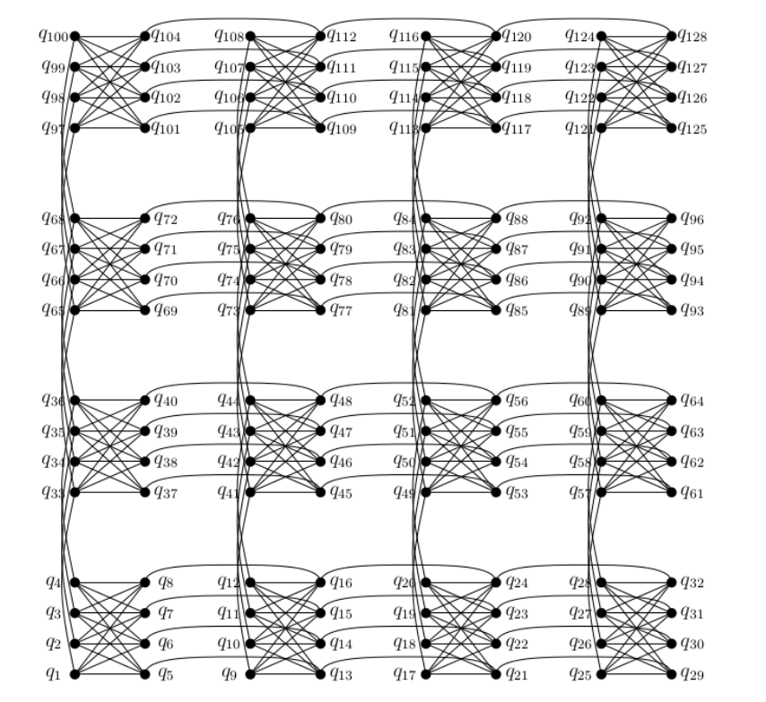
Quadratic Unconstrained Binary Optimization
Objective Term - We want to minimize the “cost” where
Cost_{ij} = Distance_{ij} × (Ability_{i}/Severity_{j} )
Penalty Term - Penalties are proportional to the “fire constraints” and “team constraints”

Slide 4
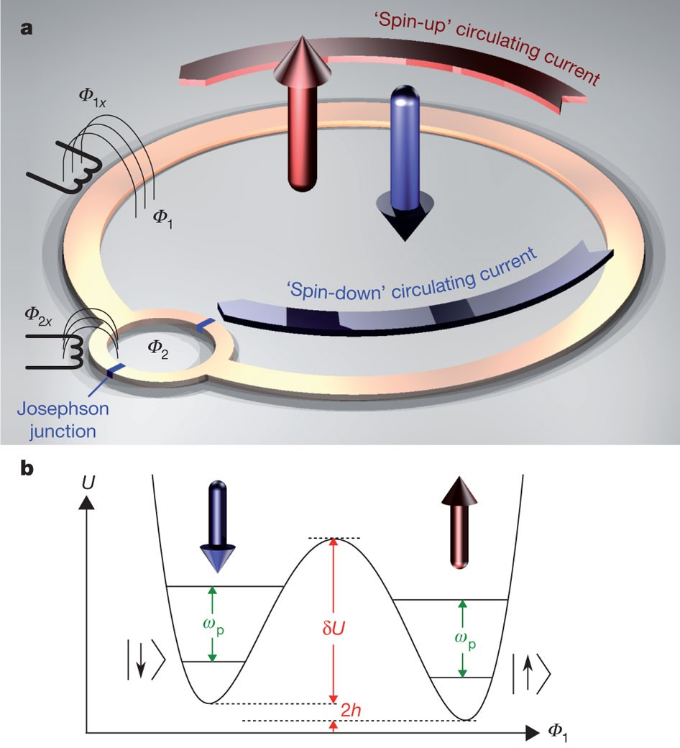
Quantum Annealing
The problem Hamiltonian represents this optimal solution.
Using quantum annealing, the particles reaching their minimum energy as a classical system coincides with the correct result has been determined.

Slide 5

Safety Measures
We must be assured that the particles in our system are behaving in a quantum manner.
The verification systems we can use for this are verification of the Eigen-spectrum using manipulation of annealing speed and measurement of freezeout time.

Slide 6
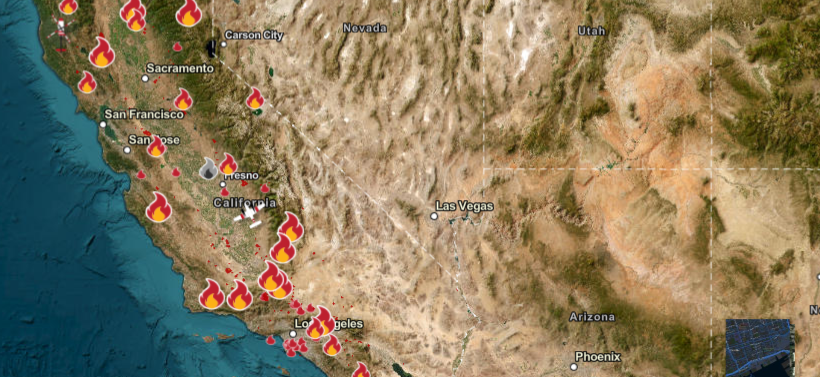
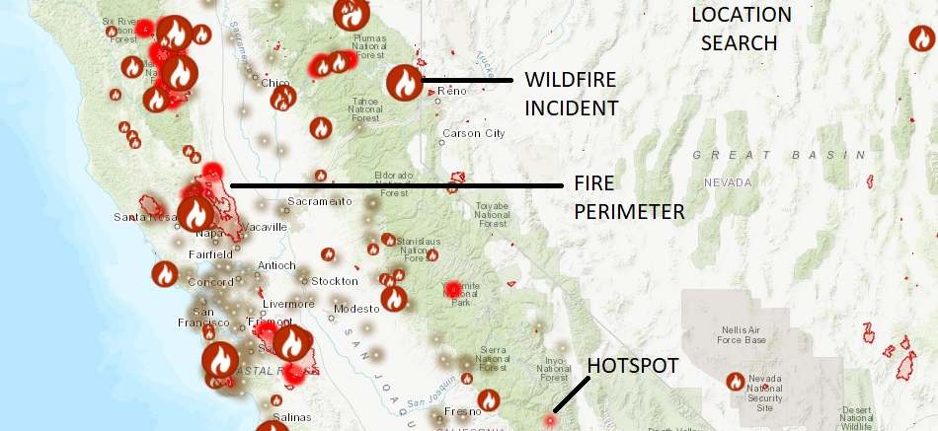
Future Steps
Using Artificial Intelligence to collect historical data and refine the quantum solutions is our hybrid that caters of the strengths of both classical and quantum computing.
Continuously mapping the team-to-fire solution from the quantum system over a map of affected areas will help fire departments to visualize the resource allocations in real time as an interactive graph.

Slide 7
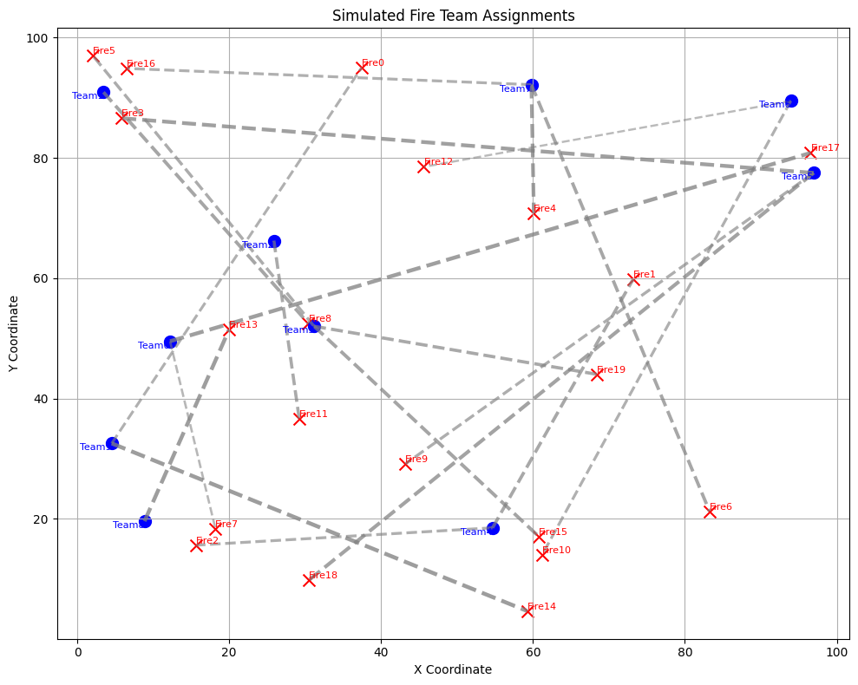
Artificial Intelligence
Ideal Team Assignments:
Team0 → Fire17 (Distance: 7.20 km, Severity: 1.72)
Team0 → Fire7 (Distance: 4.38 km, Severity: 0.41)
Team1 → Fire8 (Distance: 2.34 km, Severity: 1.33)
Team2 → Fire11 (Distance: 5.89 km, Severity: 1.13)
Team3 → Fire15 (Distance: 5.21 km, Severity: 1.36)
Team3 → Fire19 (Distance: 13.45 km, Severity: 1.19)
Team3 → Fire5 (Distance: 12.24 km, Severity: 1.01)
Team4 → Fire1 (Distance: 4.13 km, Severity: 1.21)
Team4 → Fire2 (Distance: 16.22 km, Severity: 0.87)
Team5 → Fire18 (Distance: 3.22 km, Severity: 1.51)
Team5 → Fire3 (Distance: 8.88 km, Severity: 1.63)
Team5 → Fire9 (Distance: 31.98 km, Severity: 0.92)
Team6 → Fire10 (Distance: 18.26 km, Severity: 0.82)
Team6 → Fire12 (Distance: 16.38 km, Severity: 0.26)
Team7 → Fire16 (Distance: 11.26 km, Severity: 0.83)
Team7 → Fire4 (Distance: 14.50 km, Severity: 1.58)
Team7 → Fire6 (Distance: 28.50 km, Severity: 1.27)
Team8 → Fire13 (Distance: 4.55 km, Severity: 1.74)
Team9 → Fire0 (Distance: 8.43 km, Severity: 0.76)
Team9 → Fire14 (Distance: 4.07 km, Severity: 1.79)

